Slide 1

HDV CO₂ Regulation in REPUBLIC OF KOREA
January 7, 2019
Notes:
Hello Lady and Gentleman
I’m Yunsung Lim, I have been working in NIER since 2002.
Now I work for CAFÉ and assessment about off-cycle or eco innovation for LDV.
I introduce HDV CO2 eegulation in Rep of Korea.

Slide 2
Timeline
Model structure
Input & generic data
Simulation accuracy analysis
Future work
Notes:
This time presentation contents

Slide 3
1. Timeline
Notes:
The first presentation is timeline

Slide 4
Timeline
Regulatory Timeline
1st
distribution
2nd
distribution
 | 2016 | 2017 | 2018 | 2019 | 2020 | 2021 | 2022 | 2023 | 2024 | 2025
Simulation model development
Monitoring
Legislation
Start of Regulation
Draft
Monitoring (2019 ~)
Simulation model distribution to manufacturer (1st distribution in 2016, 2nd distribution in 2017), Input data submission
Legislation (2020)
Set CO₂ reduction target, super credit, eco innovation technology, draft regulation
Start of Regulation (2021 ~)
Notes:
Regulatory timeline in South Korea.
We have been researched simulation model for HDV CO2 assessment

Slide 5
2. Model structure

Slide 6
Model structure
Simulation model: HES, Heavy-duty vehicle Emission Simulator
Calculation flow
Pre-processor
1. Test cycle
(K-WHVC mode)
2. Vehicle spec.
(input data)
Chassis
(prediction of
total resistance F)
Transmission
(gear shifting)
Engine
(engine speed, engine torque)
CO₂ emission
(FC map)
Fig. Basic model structure
Vehicle dynamic based simulation model for MHDVs (Medium and Heavy Duty Vehicles) in Korea
MHDVs simulation model (Korea): Composed of five components as follow:
  Pre-processor module: reading input data (vehicle specifications and velocity profile)
  Chassis module: calculating total resistance force acting on vehicle
  Transmission module: predicting gear position at each time step based on engine operating condition
  Engine module: determining engine torque & speed at each time step
  CO₂ emission module: predicting CO₂ emission based on fuel map & CO₂ emission factor of fuel
Backward type calculation program (wheel to engine)

Slide 7
Model structure
Test cycle (target velocity)
Fig. Comparison of original WHVC and K-WHVC mode (velocity profile)
Modification of WHVC driving mode
WHVC mode represents real driving pattern of MHDVs in Korea reasonably.
However, some HDVs (GVW>30 ton) are not able to follow the WHVC in specific acceleration regions.
K-WHVC driving cycle had been developed to enhance a correlation between simulation and test results.
Notes:
참고문헌 : “Review of Power Cylinder Friction for Diesel Engines”, Journal of Engineering for Gas Turbines and Power

Slide 8
3. Input & generic data

Slide 9
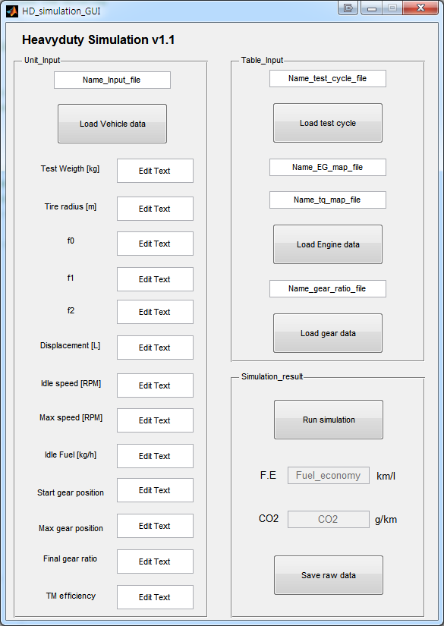
Input data
Input
Vehicle specification
Weight
Tire radius
Resistance coefficient (f0 / f1 / f2)
idling & max engine rpm
Idling fuel consumption
Engine displacement
Start gear position
Max gear position
Auxilially power demand
Driving cycle
JE05 mode
WHVC mode
K-WHVC mode (default cycle)
1
2
1
2
JE05 mode
3
WHVC mode
4
Engine
Fuel consumption map
Full load curve
Transmission
Gear ratio
Gear efficiency
3
4

Slide 10
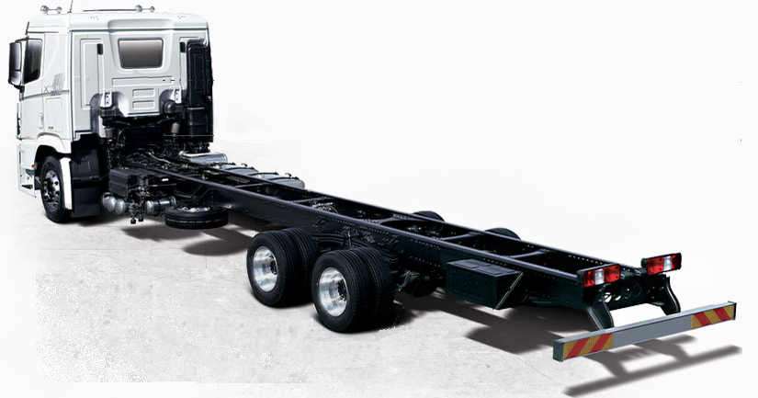
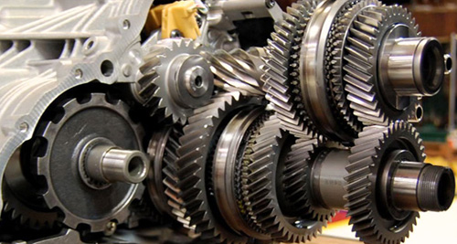
Input data
1. Vehicle specification
Vehicle type: MHDVs are divide into five classes
(heavy duty truck, medium duty truck, light duty truck, city bus, ordinary bus)
Vehicle weight: half-loaded
Tire radius: dynamic radius
Road load coefficients (derived by coast down test): F0, F1, F2
Engine displacement
Idle & maximum engine speed
Start gear position: determine 1st or 2nd gear position at start condition
Auxiliary power demand: technology list, Idle stop: Y or N
2. Transmission specification
Gear ratio: Up to 16th gear
Final gear ratio
Gear efficiency or Torque loss map
Gear type (automatic or manual transmission)

Slide 11
Input data
3. Fuel consumption map
Fuel consumption map is used to calculate a fuel consumption & CO₂ emission rate of vehicle in whole driving time.
Data composition of fuel consumption map:
- Engine speed (x axis, RPM)
- Engine BMEP (y axis, bar)
- Fuel consumption rate. (z axis, kg/h)
Interpolation method is important to increase prediction accuracy
Fig. Fuel consumption map
4. Engine full load characteristic curve
Engine full load characteristic curve data is used to calculate a maximum engine torque in whole driving time.
Engine full load characteristic curve data is also used to calculate a normalized torque & torque margin.
Fig. Engine full load characteristic curve

Slide 12
Generic data
5. Test cycle & weighting factor
Urban: 0-900 sec
Rural: 901-1,368 sec
Motorway: 1,369-1,800 sec
Fig. K-WHVC test cycle
Table. Weighting factor for MHDVs of Korea
Type | Weighting factor (Urban : Rural : Motorway)
City bus | 9 : 1 : 0
Ordinary bus | 1 : 2 : 7
Light-duty Truck | 2 : 4 : 4
Medium-duty Truck | 1.5 : 3.5 : 5
Heavy-duty Truck | 1 : 3 : 6
K-WHVC mode is composed of three phases
- Urban (0-900 sec)
- Rural (901-1,368 sec)
- Motorway (1,369-1,800 sec)
Weighting factor is differently applied at each MHDVs (divided into five classes)

Slide 13
4. Simulation accuracy analysis

Slide 14
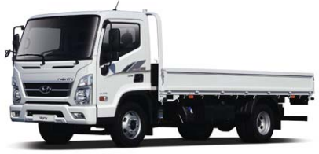
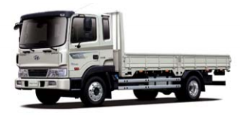
Simulation accuracy analysis
Rigid Truck test
Type | GVW (ton) | Max payload (ton) | Displacement (L) | Model year
Rigid truck | 7.2 | 3.5 | 3.9 | 2017
Rigid truck | 10.4 | 4.5 | 6.3 | 2017

Slide 15
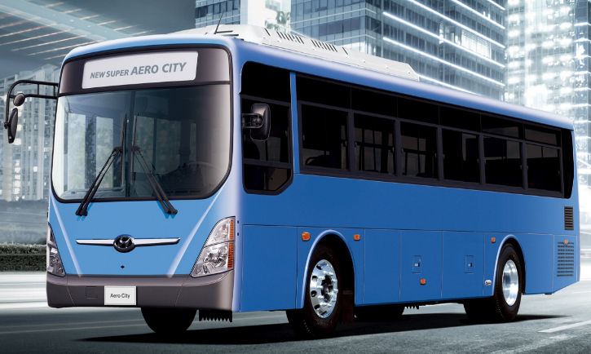
Simulation accuracy analysis
City bus test
Engine | Peak power | Displacement | Weight | Passenger capacity | Transmission | Model year
CNG C6AF | 290 PS | 11.6 L | 13.09 Ton | 54 | Manual | 2017

Slide 16
Simulation accuracy analysis
HDV simulation
423 HDVs simulation
Diesel HDV 370 cases, CNG HDV 53 cases
Half payload test
K-WHVC simulation (weighting factors of Driving cycle are not applied)
Notes:
In previous research, we analyzed as many vehicle as possible by using HES model.
This graph shows the Korea Heavy-duty vehicle simulation results.
423 vehicle specifications are used for simulation calculation.
Red points are diesel simulation results and green points are CNG simulation results.
Diesel heavy-duty vehicles account for 97% of total Heavy-duty vehicles in Korea, and rest of HDVs are CNG buses.
The vehicle specifications, which are used for this graph, are collected by Ministry of Environment before 2015
From this year 2019, we plan to start monitoring on heavy-duty vehicle CO2 emission.
So, more detailed and accurate vehicle data will be used for this kind of research in this year.
Considering monitoring result of this year , we will decide CO2 reduction rate of heavy duty vehicle.

Slide 17
5. Future work

Slide 18
Future work
Future work: HDV CO₂ Regulation
2019: HDV CO₂ emission monitoring
  Vehicle data submission (OEMs)
  Accurate calculation of CO₂ emission from HDVs
2020: Legislation process
    Public hearing about CO₂ emission regulation
    Determination of CO₂ reduction rate
2021: Start of CO₂ emission regulation from HDVs

Slide 19
Thanks for your attention

