Slide 1
Japanese Fuel Efficiency Standard for Heavy Duty Vehicles
Environmental Policy Division,
Road Transport Bureau,
Ministry of Land, Infrastructure, Transport and Tourism,
Japan

Slide 2
1. Background
2. History of Developing FE Standard
3. Outline of Standard
4. Test Method

Slide 3
1. Background
2. History of Developing FE Standard
3. Outline of Standard
4. Test Method

Slide 4
CO2 Emission from Transport Sector in Japan
CO2 emissions from automobiles account for 15% of total emissions in Japan, and these from heavy duty vehicles account for 30% of automobiles.
It is important to reduce CO2 from heavy duty vehicles to achieve Japan’s CO2 reduction target.
CO₂ emission
（million ton）
1.87 million ton reduction per year
240
225
209
Other transportation
163
Automobile
(except heavy duty vehicle)
Emission Reduction Target
(▲25% by 2030 compared to 2013)
necessary to reduce 3.64 million ton per year
Heavy duty vehicle

Slide 5
1. Background
2. History of Developing FE Standard
3. Outline of Standard
4. Test Method

Slide 6
History of Developing Fuel Efficiency Standard
2004 Start to consider the fuel efficiency standard for heavy duty vehicles
2006 Development of the standard
・ Target year : 2015
・ Aim to improve fuel efficiency by 12.2% from 2002
・ Test method : Simulation
・ Combining JE05 mode (simulated urban area) and High-way mode
2010 Add the test method of Idle stop and AT
2012 Start to consider the new fuel efficiency standard for further CO2 emission reduction
2017 Development of the new standard
・ Target year : 2025
・ Strengthen regulation by 13.5% compared to 2015 standard
・ Amend the test method
- running resistance and engine map measurement method

Slide 7
1. Background
2. History of Developing FE Standard
3. Outline of Standard
4. Test Method

Slide 8
Scope and category
Japanese standard for HD applies to vehicles using diesel fuel and exceeding 3,500kg. (such as trucks, trailer and buses)
The standard was set for each category according to the vehicle weight for each type.
Trucks and Tractor
Buses
Category |  |  |  | 2025 Standard value
Truck | T1 | 3.5t<GVW<=7.5t | PL<=1.5t | 13.45
 | T2 |  | 1.5t<PL<=2t | 11.93
 | T3 |  | 2t<PL<=3t | 10.59
 | T4 |  | 3t<PL | 9.91
 | T5 | 7.5<GVW<=8t |  | 8.39
 | T6 | 8t<GVW<=10t |  | 7.46
 | T7 | 10t<GVW<=12t |  | 7.44
 | T8 | 12t<GVW<=14t |  | 6.42
 | T9 | 14t<GVW<=16t |  | 5.89
 | T10 | 16t<GVW<=20t |  | 4.88
 | T11 | 20t<GVW<=25t |  | 4.42
Tractor | TT1 | GVW<=20t |  | 3.31
 | TT2 | 20t<GVW |  | 2.32
Category |  |  | 2025 Standard Value
Route Bus | BR1 | 3.5<GVW<=8t | 7.15
 | BR2 | 8t<GVW<=10t | 6.30
 | BR3 | 10t<GVW<=12t | 5.80
 | BR4 | 12t<GVW<=14t | 5.27
 | BR5 | 14t<GVW | 4.52
Tour Bus | B1 | 3.5t<GVW<=6t | 9.54
 | B2 | 6t<GVW<=8t | 7.73
 | B3 | 8t<GVW<=10t | 6.37
 | B4 | 10t<GVW<=12t | 6.06
 | B5 | 12t<GVW<=14t | 5.29
 | B6 | 14t<GVW<=16t | 5.28
 | B7 | 16t<GVW | 5.14

Slide 9
New fuel efficiency standard for trucks (2025 standard)
The 2025 fuel efficiency standard is 7.63 km / L on average for the all category.
This standard is strengthened by 13.4% compared to 2015 standard.
Fuel efficiency (km/L)
Truck
Tractor
T1
T2
T3
T4
T5
T6
T7
T8
T9
T10
T11
TT1
TT2
8
(Category)

Slide 10
New fuel efficiency standard for buses (2025 standard)
The 2025 fuel efficiency standard is 6.52 km / L on average for the all category.
This standard is strengthened by 14.3% compared to 2015 standard.
Fuel efficiency (km/L)
Route bus
Tour bus
2025 standard
2015 standard
average fuel efficiency in 2014
BR1
BR2
BR3
BR4
BR5
B1
B2
B3
B4
B5
B6
B7
(Category)

Slide 11
1. Background
2. History of Developing FE Standard
3. Outline of Standard
4. Test Method

Slide 12
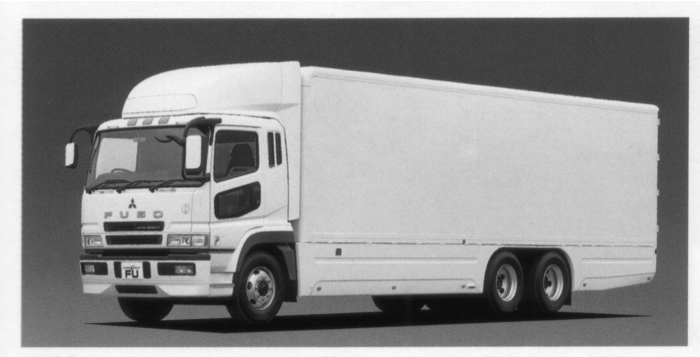
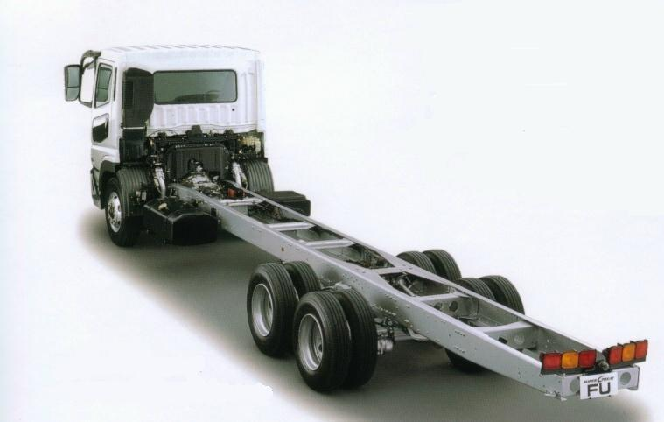
Characteristic of heavy duty vehicles
In heavy duty vehicles, there are many kinds of power train depending on difference of horse power, transmission and differential. There are also many types of body depending on difference of wheelbase and tire size.
In the trucks which account for about 90% of the number of heavy duty vehicles, these are shipped mainly in semifinished state, and the rear body is selected by the user to be a completed vehicle.
Therefore, it is difficult to measure with real vehicles which have many pattern, so in Japan has adopted the test method to calculate fuel efficiency using simulation since 2006.

Slide 13
Outline of test method
Fuel
Consumption
- JE05 mode
- High-way mode
Full Torque Curve
Conversion
&
Calculation
Program
Engine
Gear ratio, Eff.
Gear ratio,Eff.
Dia.
T/M
F/G, Tire
Combined
Fuel
Consumption km/L
Vehicle Specification
Torque Nm
Fuel flow L/h
(Measured)
- Payload
- Running resistance
Engine speed rpm

Slide 14
Test cycle and weighting factor
Fuel efficiency of heavy vehicles is calculated by combining fuel efficiency simulated by “JE05 mode" and “High-way mode" at high-way ratio determined for each category.
Category |  | High-way Ratio | Payload Ratio
Truck | T1 | 15% | 45%
 | T2
 | T3
 | T4
 | T5 | 35% | 50%
 | T6 | 40%
 | T7
 | T8
 | T9
 | T10
 | T11 | 55% | 55%
Tractor | TT1 | 45% | 50%
 | TT2
Route Bus | BR1 | 0% | 35%
 | BR2
 | BR3
 | BR4
 | BR5
Tour Bus | B1 | 15% | 60%
 | B2
 | B3
 | B4 | 45% | 65%
 | B5
 | B6 | 55%
 | B7
JE05 mode
Vehicle Speed (km/h)
Time (s)
High-way mode
８０km/h一定、勾配付
縦断勾配 %
Time (s)
Notes:
13
Next, I'll speak about the driving cycles.
Heavy-duty vehicle are used in urban and intercity expressway.
So, both driving cycle have to be examined.
JE05 is representative as urban driving, so, JE05 is decided as urban driving cycle.

Slide 15
Accuracy of simulation method
The simulation method adopted as the heavy duty vehicle fuel efficiency measurement method in Japan has a comparatively small error from the measurement on the vehicle base.
10
y = 0.993x
R
2
= 0.9952
8
6
Fuel efficiency by simulation (km/L)
4
Vehicle A (JE05)
Vehicle A (High-way)
2
Vehicle B (JE05)
Vehicle B (High-way)
0
0
2
4
6
8
10
Fuel efficiency by measurement (km/L)
Notes:
14
Next, I'll speak about the driving cycles.
Heavy-duty vehicle are used in urban and intercity expressway.
So, both driving cycle have to be examined.
JE05 is representative as urban driving, so, JE05 is decided as urban driving cycle.

Slide 16
Input data into simulation
Item | Amendment from 2025 standard
Aero drag | Introduction of aerodynamic resistance coefficient of individual car
Tire rolling resistance | Reflecting tire rolling resistance coefficient
Shift Logic | Update shift point
Rotational inertial mass | Equivalent rotating mass inertial mass review
Standard vehicle specifications | Update the standard vehicle specifications
Transient compensation | Introduction of transient compensation coefficient
Fuel consumption map measurement | Increase measuring point
Weighting factor (High-way ratio and Payload ratio) | Update high-way ratio and payload ratio

Slide 17
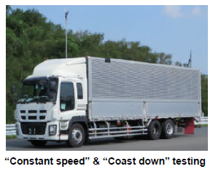
Measurement : Aero drag
1) Aero drag measurement method
How to measure Cd coefficient like coast down, etc with correction using wind flow meter.
→ “Constant speed (with wheel torque meter)” and “Coast down “
“Anemometer” is Option
CFD and wind tunnel. → N/A

Slide 18
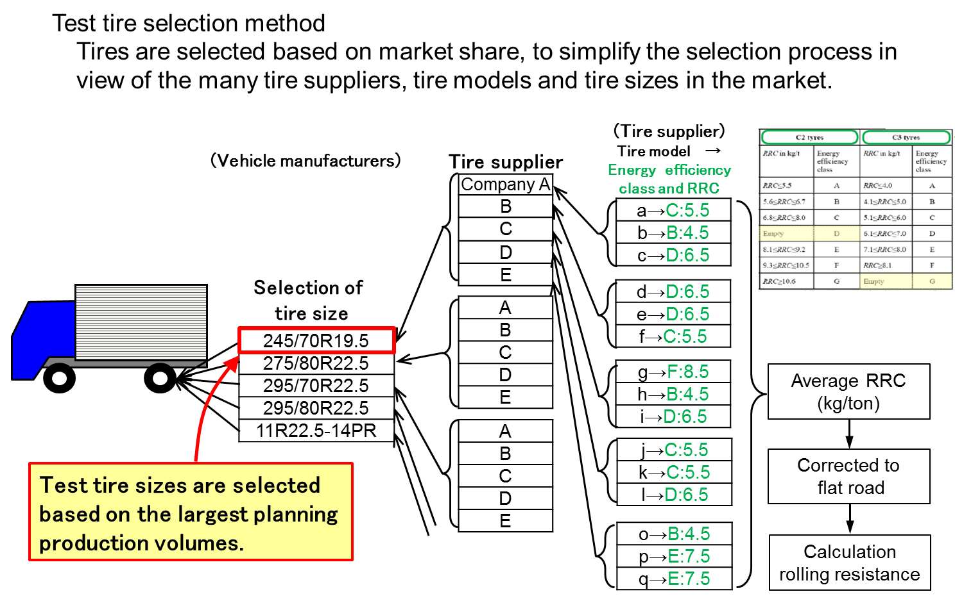
Measurement : Tire rolling resistance
1) Tire rolling resistance
How to measure tire rolling resistance. → ISO28580
2)Resistance select method
How to select the rolling resistance.
Unique value of tire or value using ranking of tire.

Slide 19
Measurement : Engine Map
1) Steady state engine map
Number of points, measuring order, and measuring process like sweep time and measuring time, etc.
Current FES
Next FES
Engine speed 6 ×Torque 5
+ Idling = 31points
Engine speed 10 ×Torque 5
+ Idling = 51points

Slide 20
Thank you for your attention!

